Slide 1

100 Years of Music

Slide 2

100 Years of Music: The stakeholder
ROLLING STONE is publishing a special number on how music has changed over the last century
Different ASPECTS of music across different ERAS will be taken into account
SPOTIFY DATASET composed by over 170.000 songs
For better marketability, the cover will tease a final POPULARITY showdown for artists and songs according to modern listeners

Slide 3

PREPROCESSING AND UNIVARIATE ANALYSIS
Read.csv
Detecting outliers
Detecting subsets
Var distribution
Eras definition
Shape Analysis

Slide 4

Detecting outliers (1/2)
Take a look at the data!
Max duration = 1h 30 min
Min duration = 5 sec
Part of it could be useless or even misleading!
What do we leave behind?
Symmetrical cutting (± 1.5*IQR) won’t work!
Asymmetrical cutting (+ 6*IQR) seems good!

Slide 5


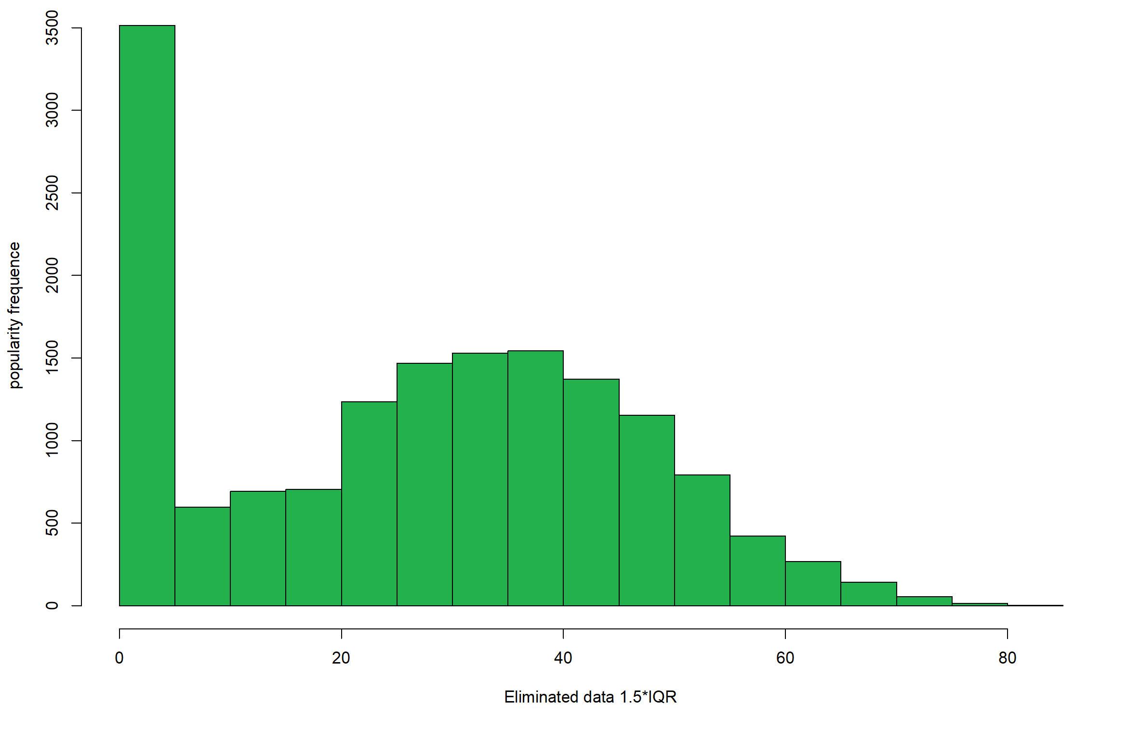
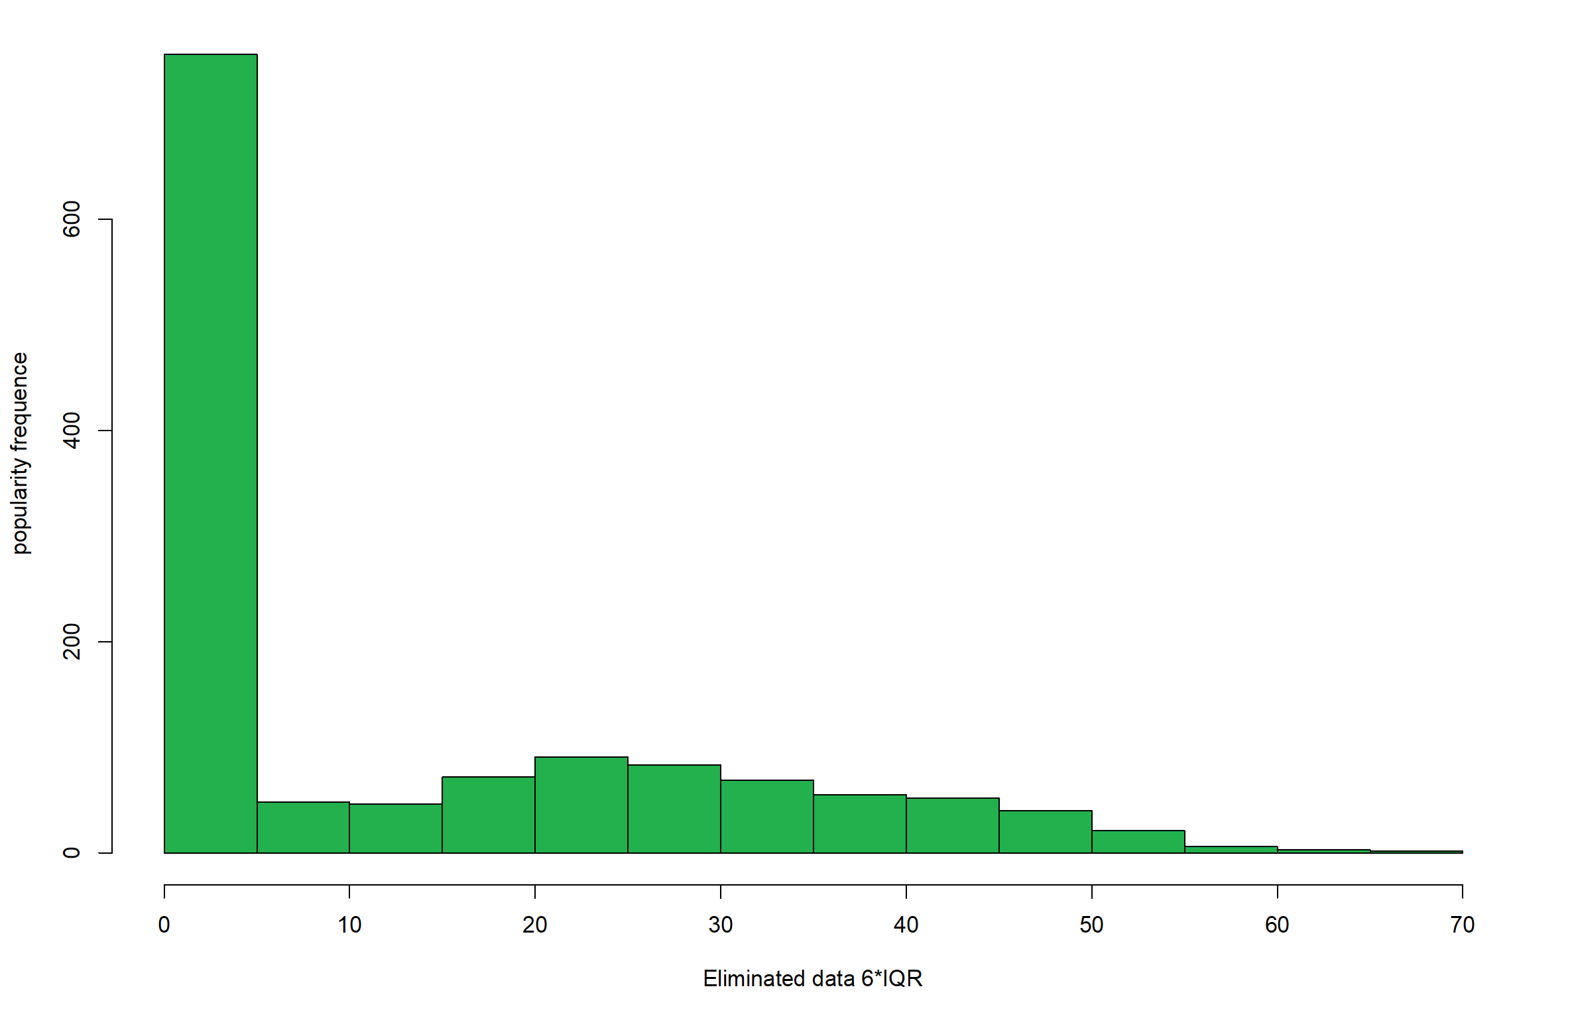
Detecting outliers (2/2)
An Example: Popularity
Symmetrical cutting
Asymmetrical cutting
An algorithm based on the total number of plays the track has had and how recent those plays are
(Ranges from 0 to 100)

Slide 6

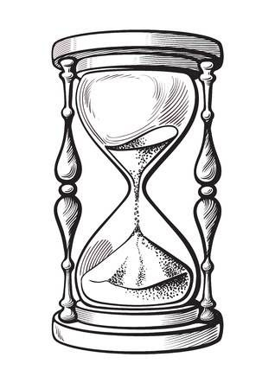
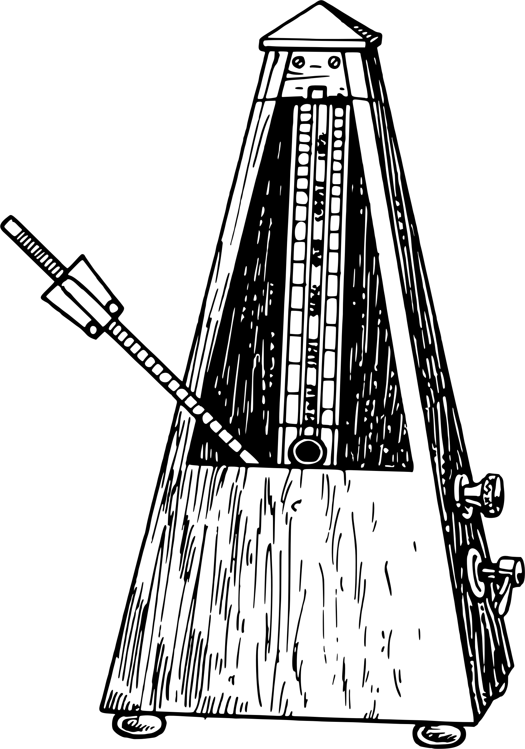
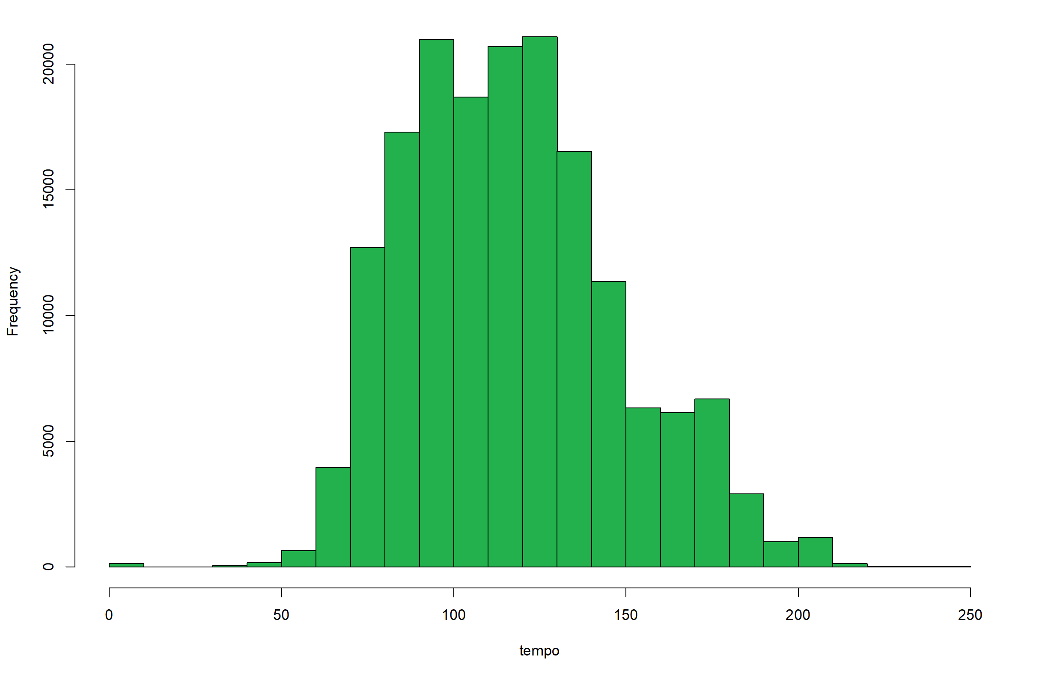
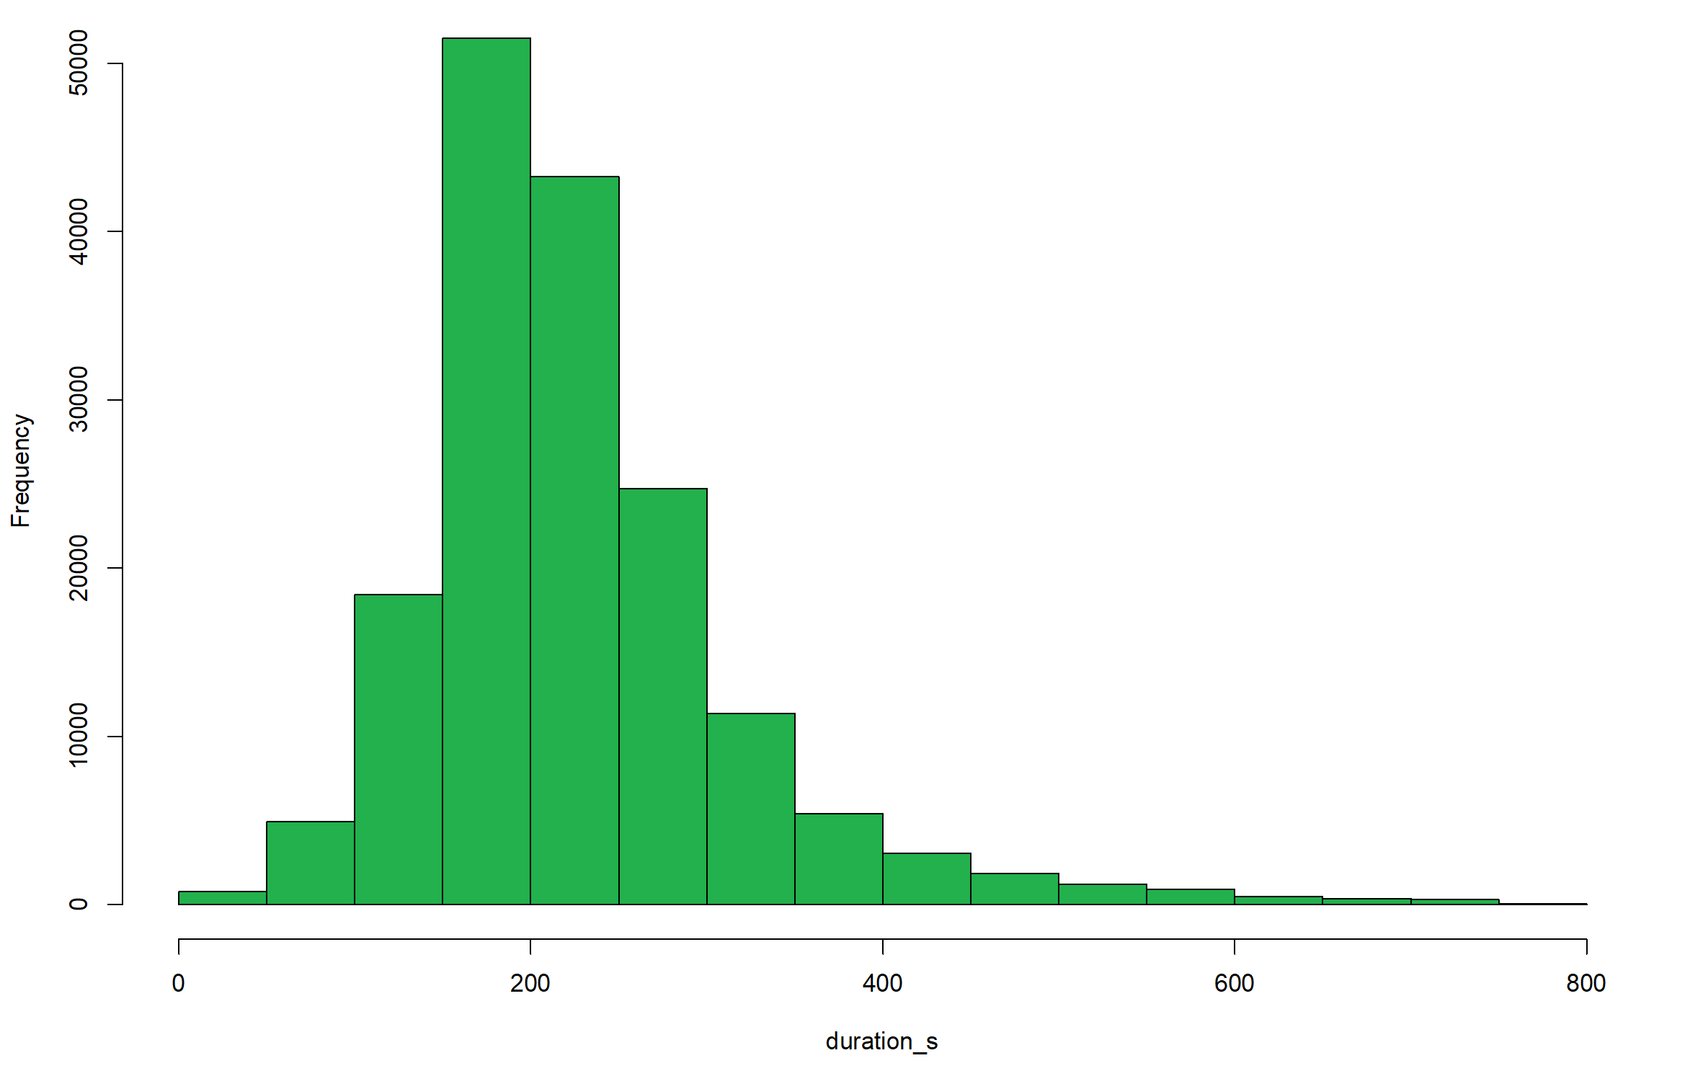

Variables distribution (1/2)
Taking a look to a few distributions…
Duration distribution
Tempo distribution
Tempo is the speed or pace of a given piece in beats per minute (BPM)
(Ranges between 50 to 150)
The length of the track in seconds (originally in milliseconds)

Slide 7

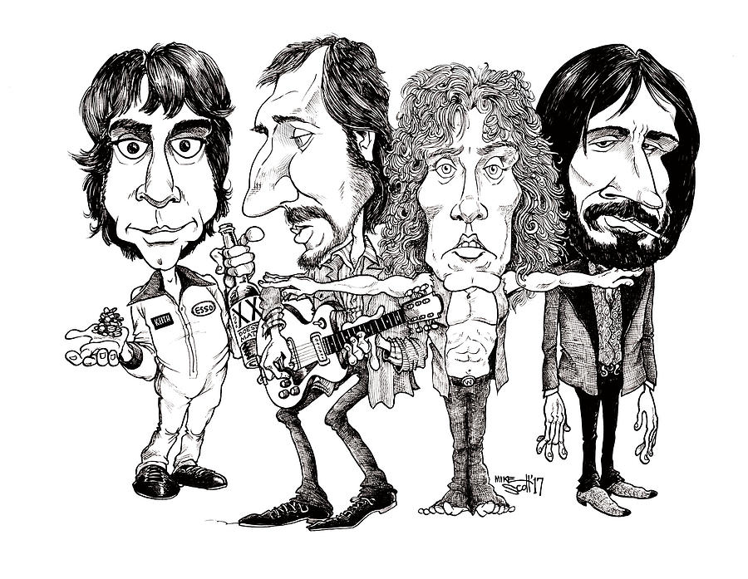
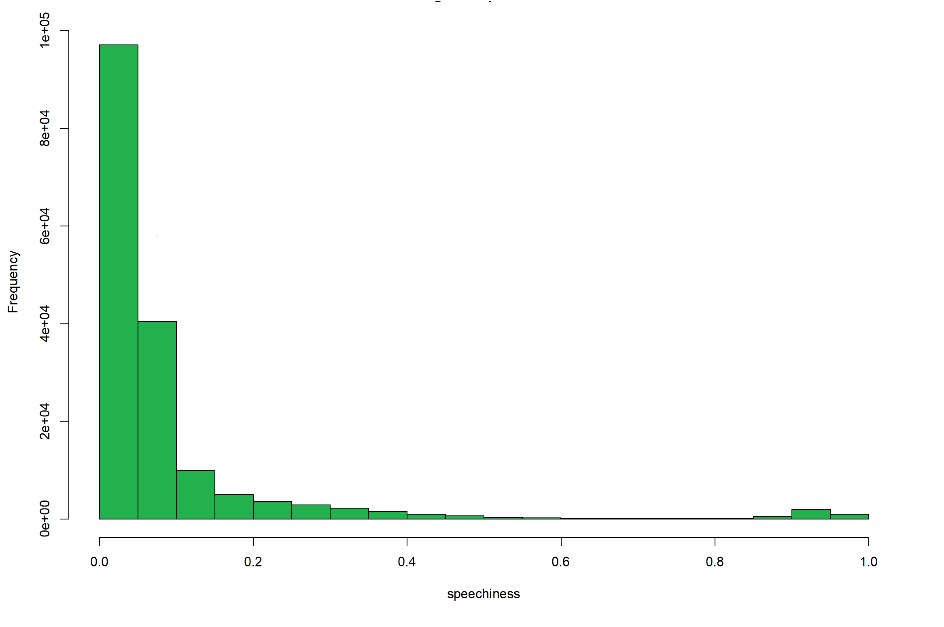
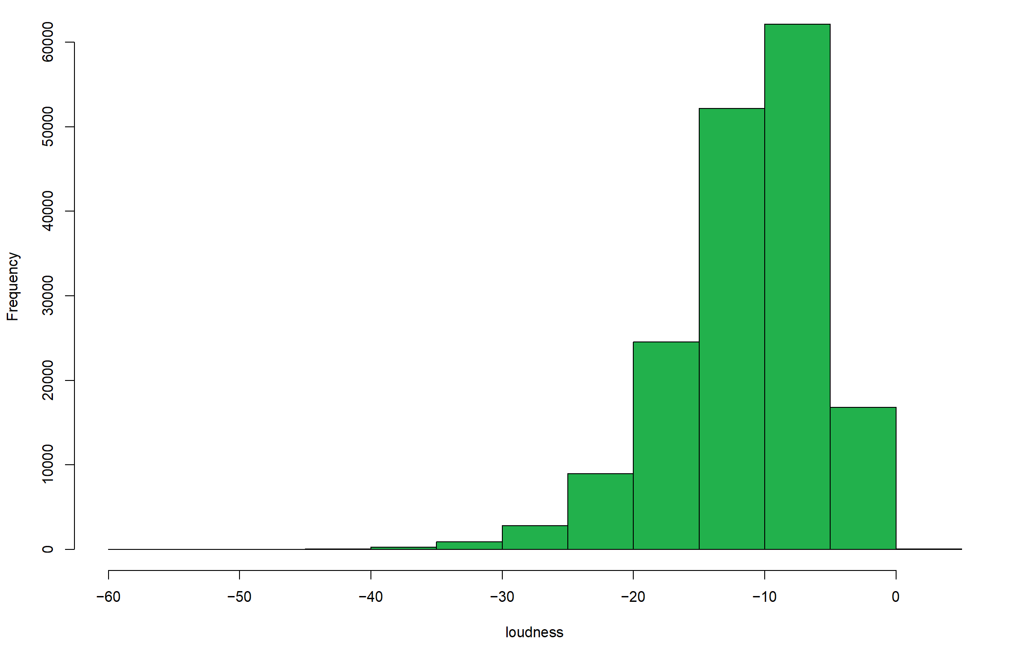

Variables distribution (2/2)
Taking a look to a few distributions…
Loudness distribution
Speechiness distribution
The average loudness of a track in decibels (dB)
Also correlated to perceived sound quality
(Ranges between -60 and 0 dB)
Measures the presence of spoken words in a track
Ranges from 0 to 1
Values above 0.66 detects only spoken tracks (podcasts, etc…)

Slide 8
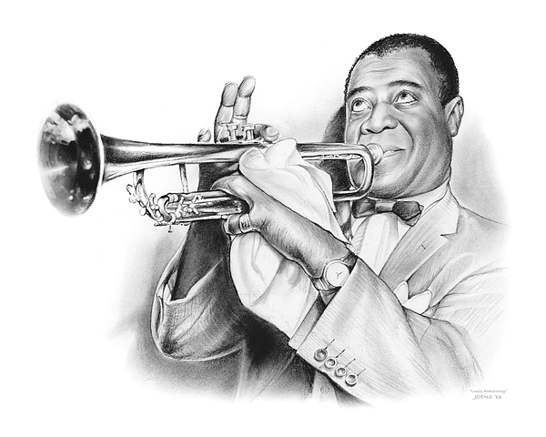

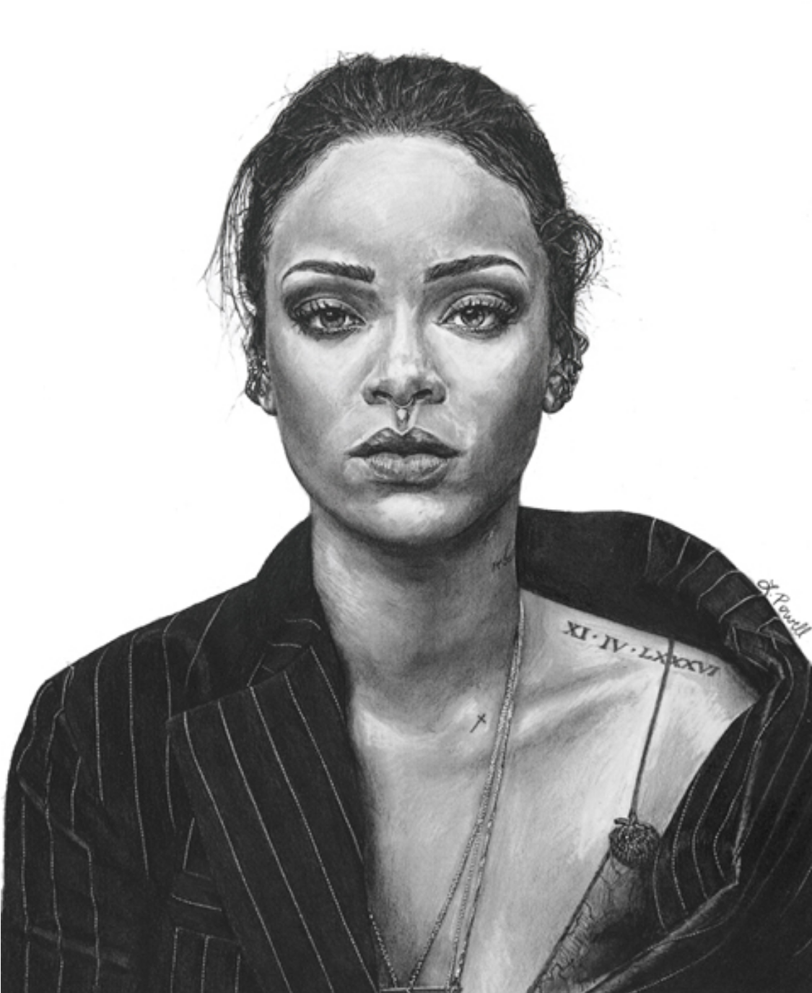
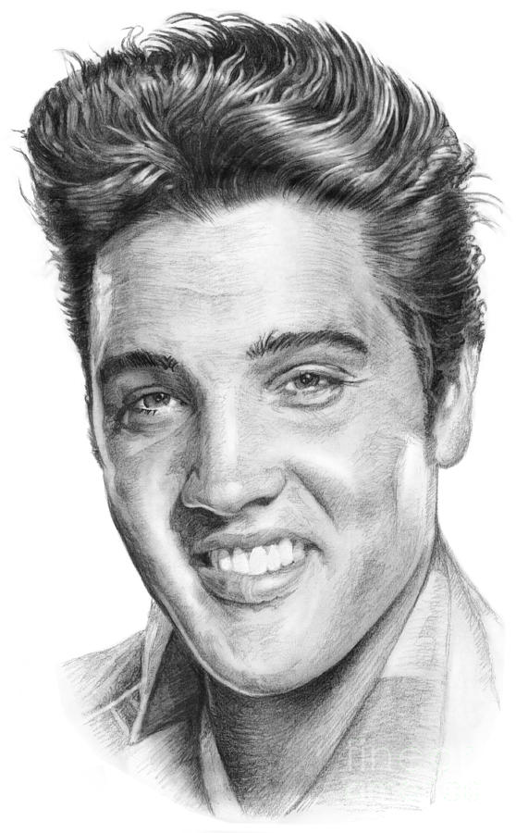
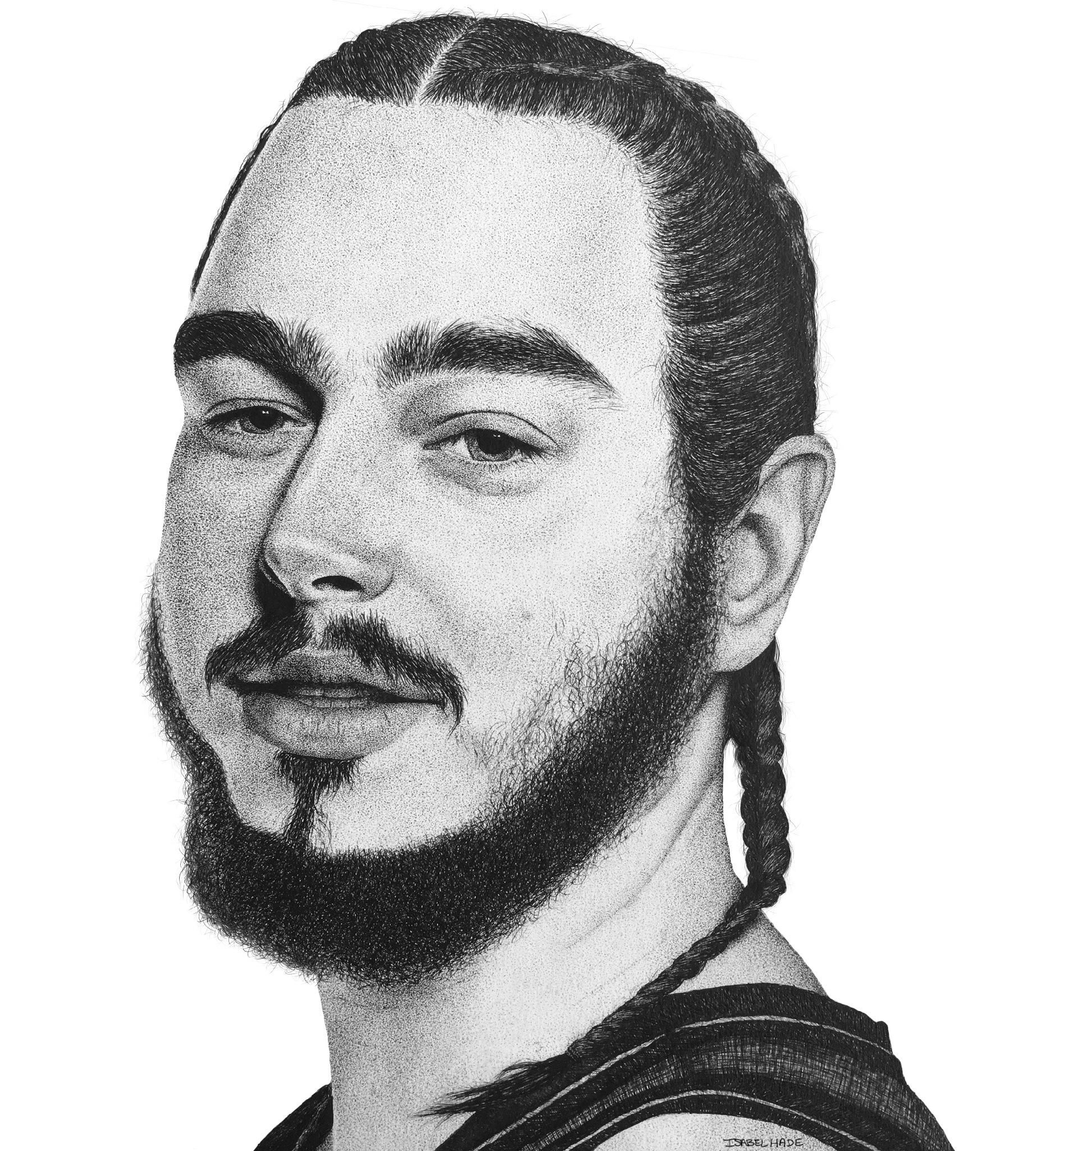
ERAS DEFINITION
1920’s – 1940’s
1950’s – 1970’s
1980’s – 1990’s
2000 – 2010
2010 – 2020

Slide 9
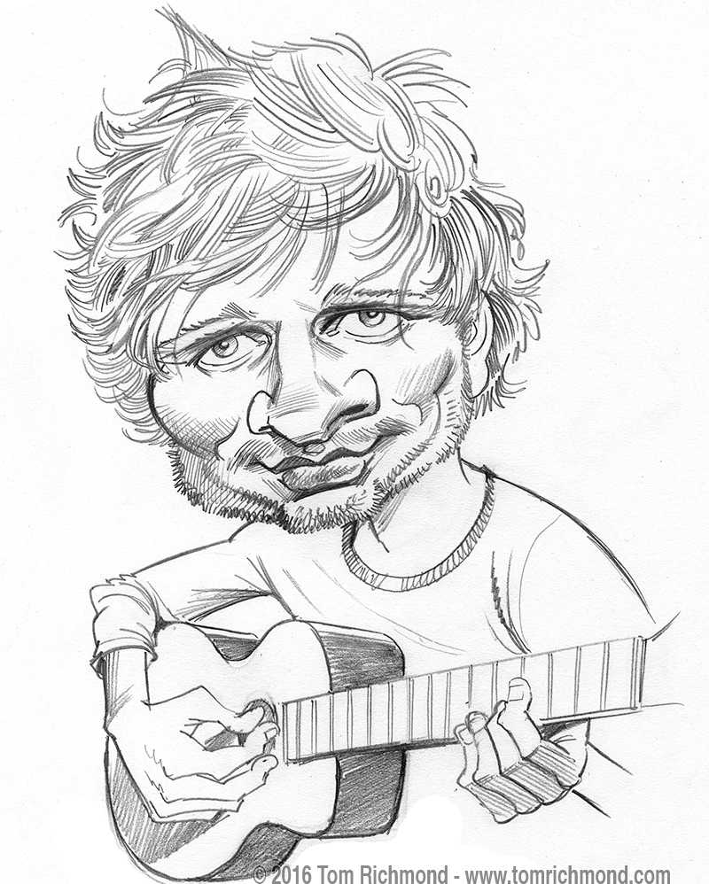
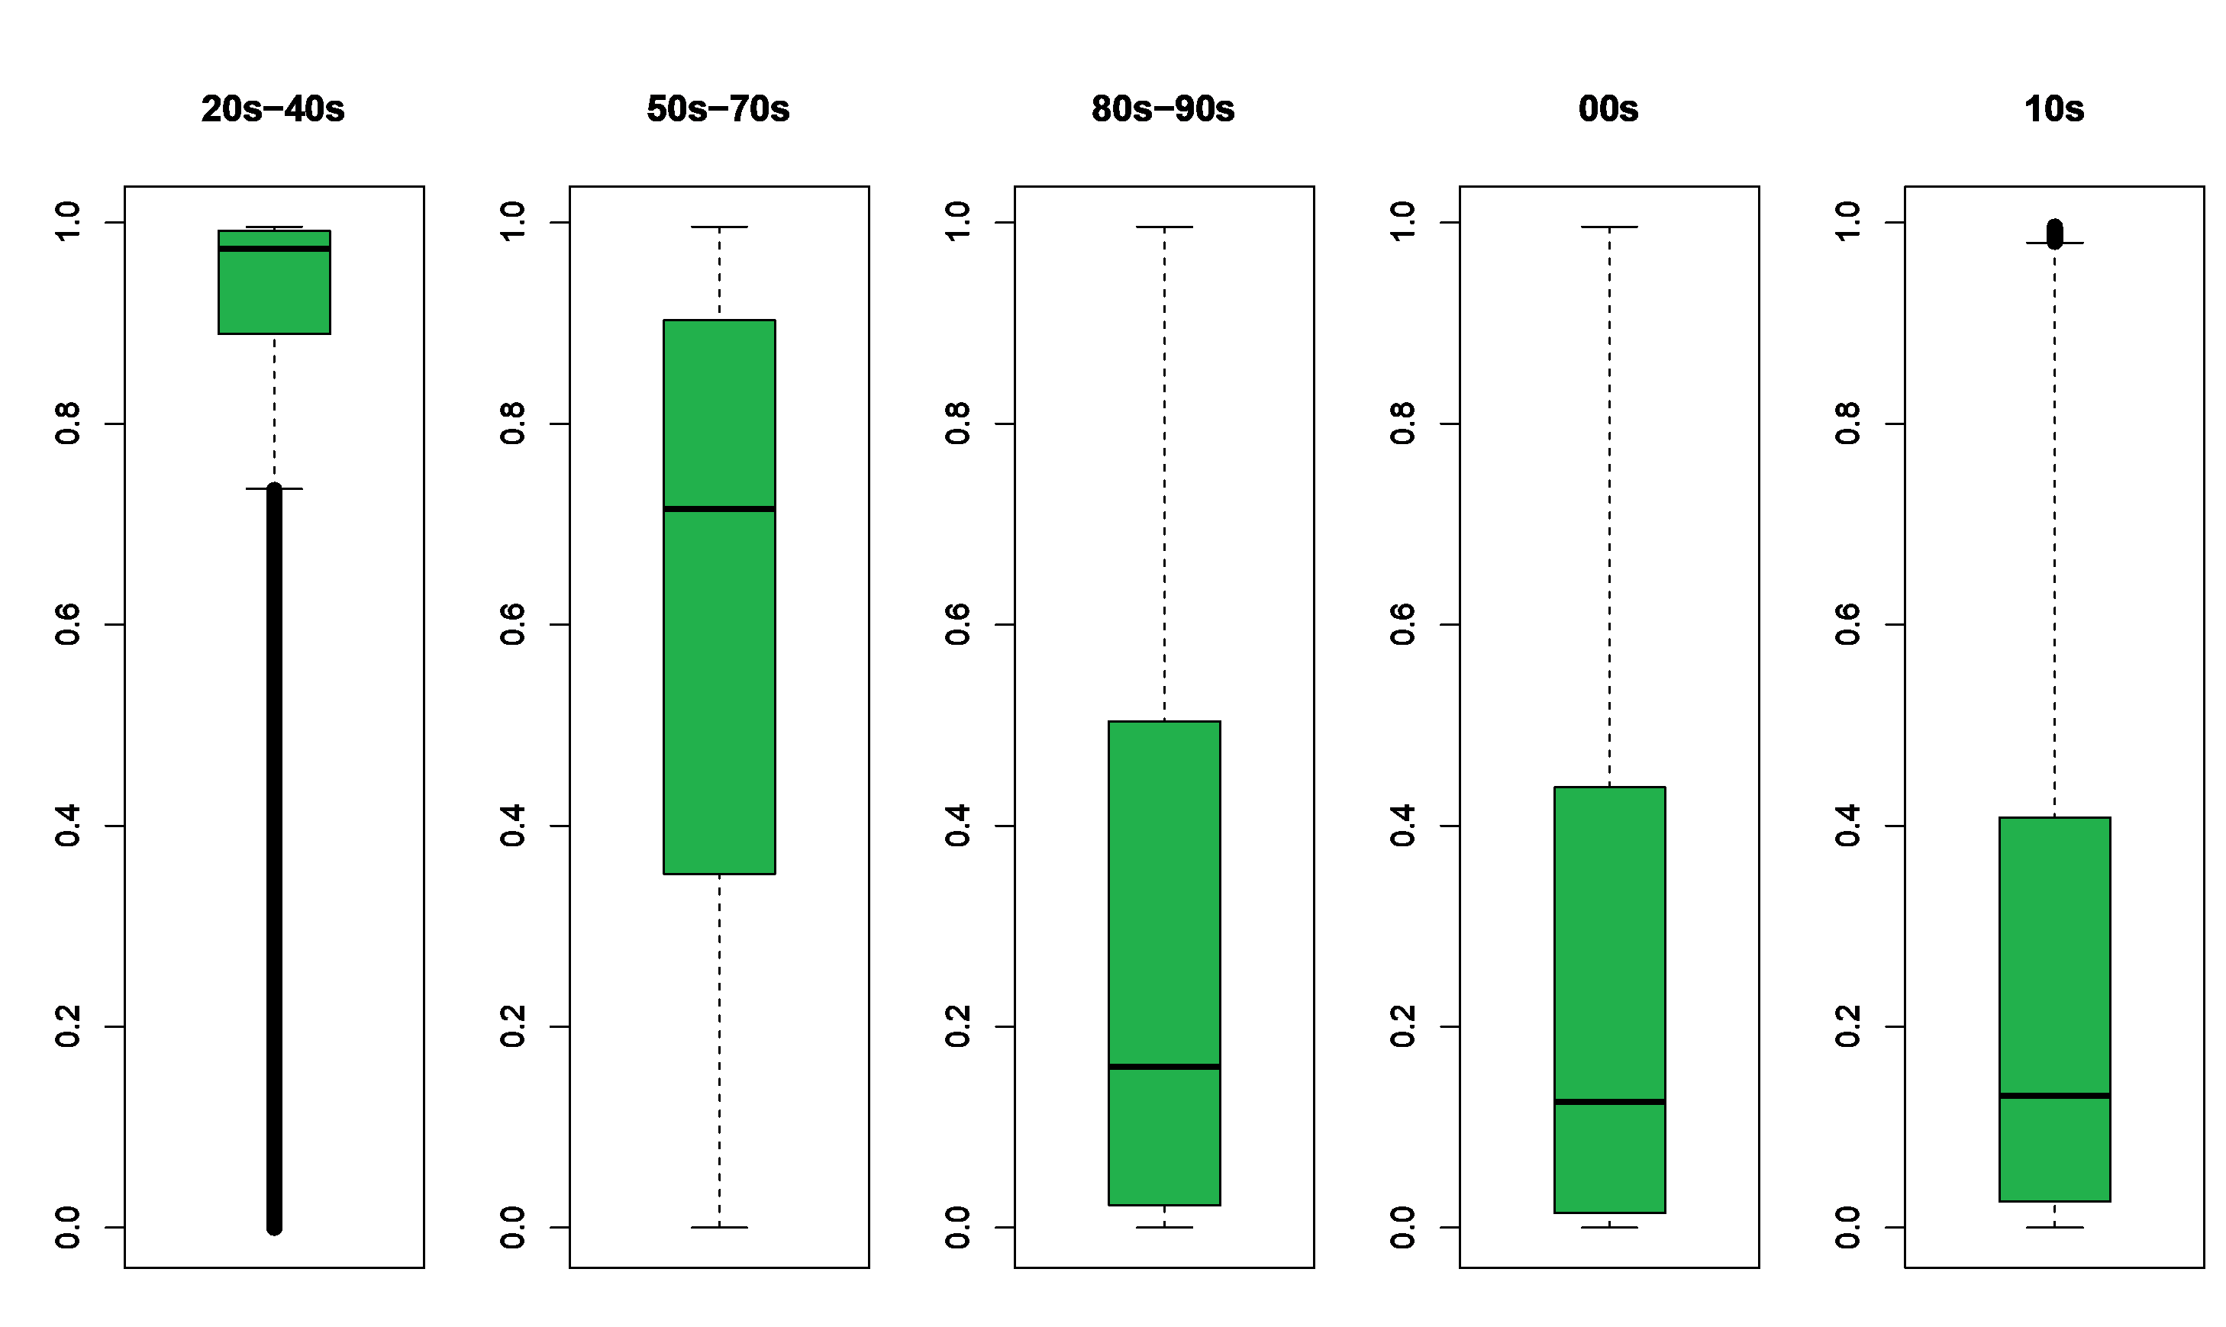
Shape analysis (1/4)
Our goal:
Visualizing shifts both grafically and numerically
Acousticness
*
What we did:
We boxplotted the different variables for each era
We measured their skewness to understand the magnitude of the shifts
We measured their kurtosis to identify convergences in musical trends
A confidence measure from 0.0 to 1.0 of whether the track is acoustic
1.0 represents high confidence the track is acoustic
* Between 70’s and 80’s digital synthesizers (much cheaper than analog ones) appear on the market

Slide 10

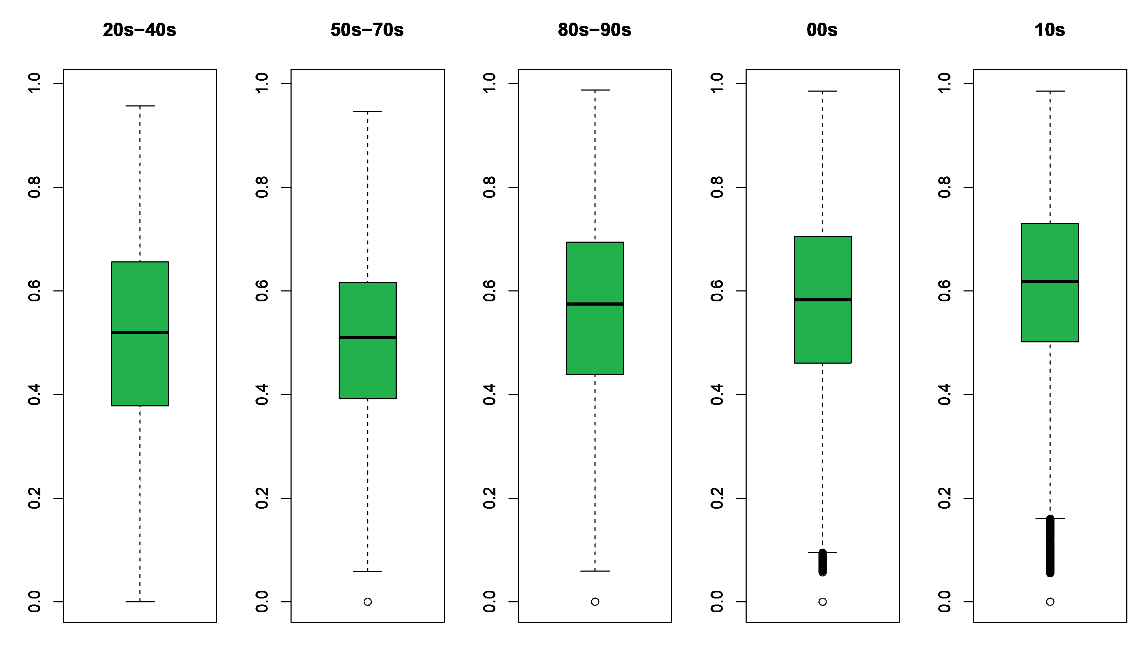
Shape analysis (2/4)
Danceability
How suitable a track is for dancing based on a combination of musical elements
A value of 0.0 is least danceable and 1.0 is most danceable
Some of them shift smoothly…

Slide 11
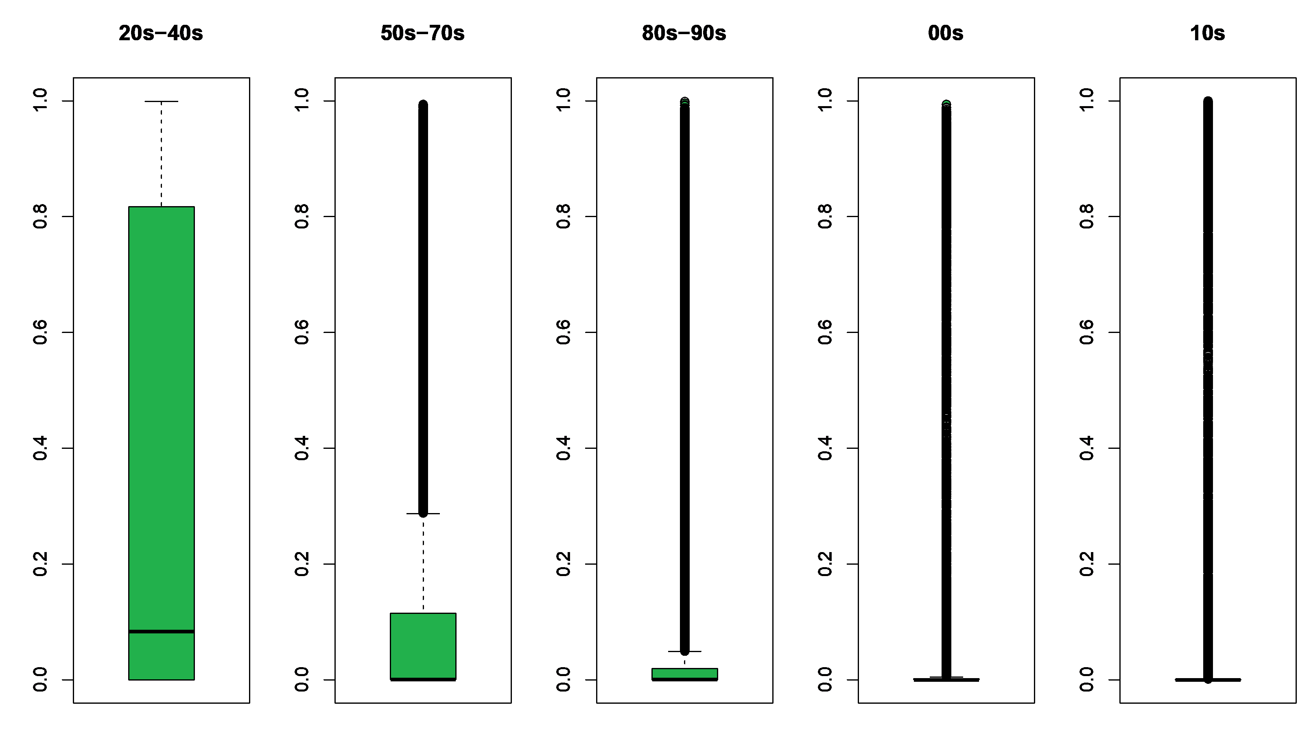

Shape analysis (3/4)
Instrumentalness
Some other, well... not really
Through proper visualization we exaggerate the shifts across different periods
Previous to the 40s vocals were not mandatory in order to make music
Nowadays it seems quite the opposite!
Predicts whether a track contains no vocals
Ranges between 0 and 1
A value of 1 corresponds to no vocals

Slide 12

Shape analysis (4/4)
Shifting trend!
Steady trend!

Slide 13
MULTIVARIATE ANALYSIS
Variance Covariance
Correlation
PCA
Star plot

Slide 14
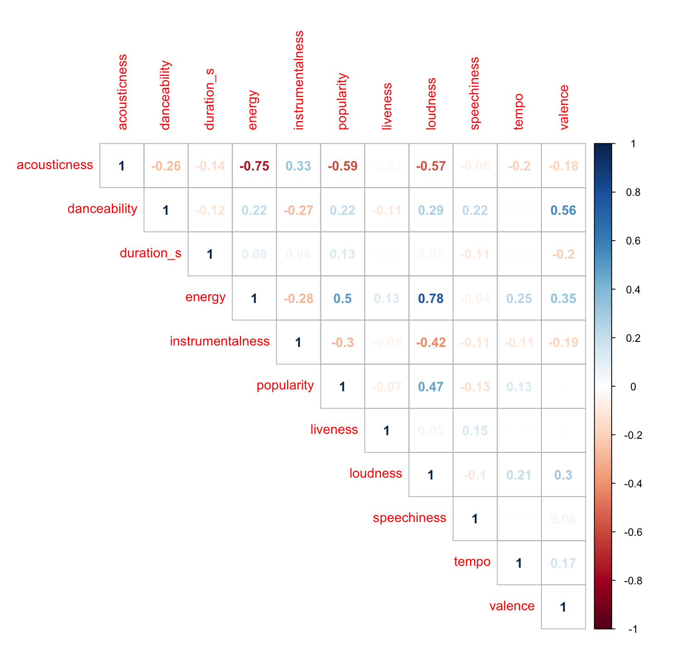
Correlation
The dataset present an overall weak correlation between variables
Thus, it will be difficult to find few ortogonal (non-correlated) principal components capable of explainining an high percentage of the dataset variability

Slide 15
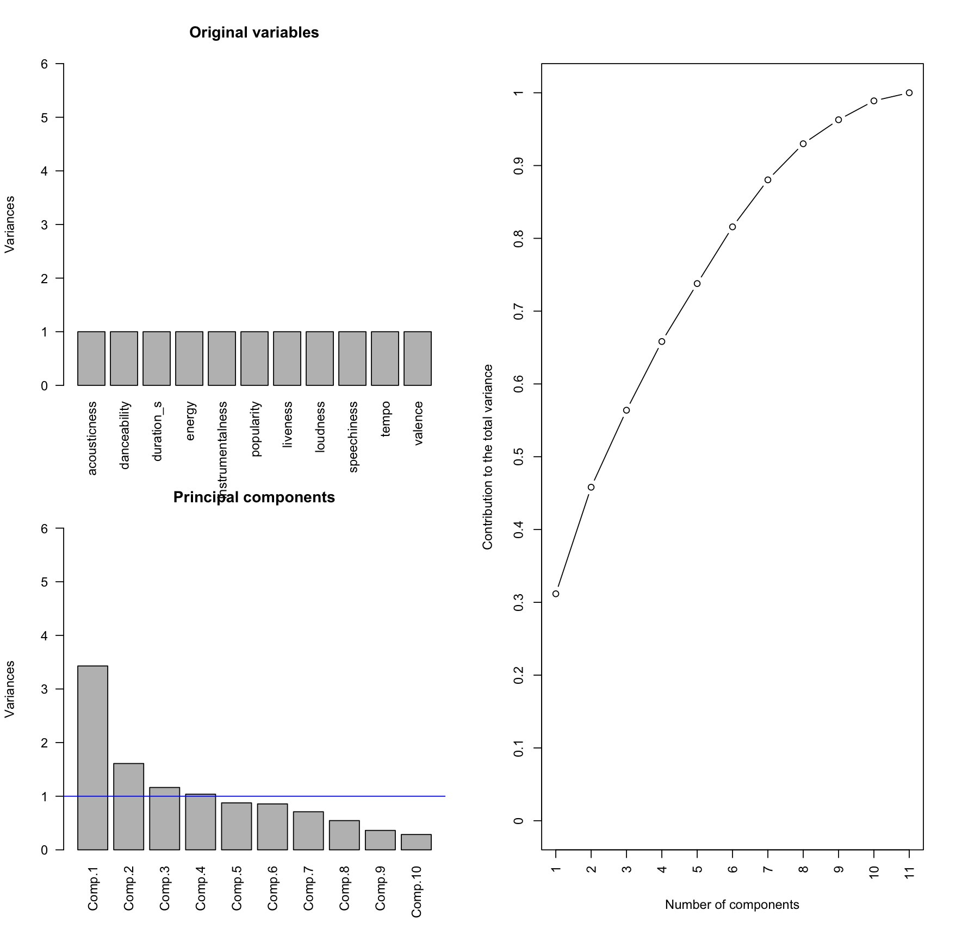
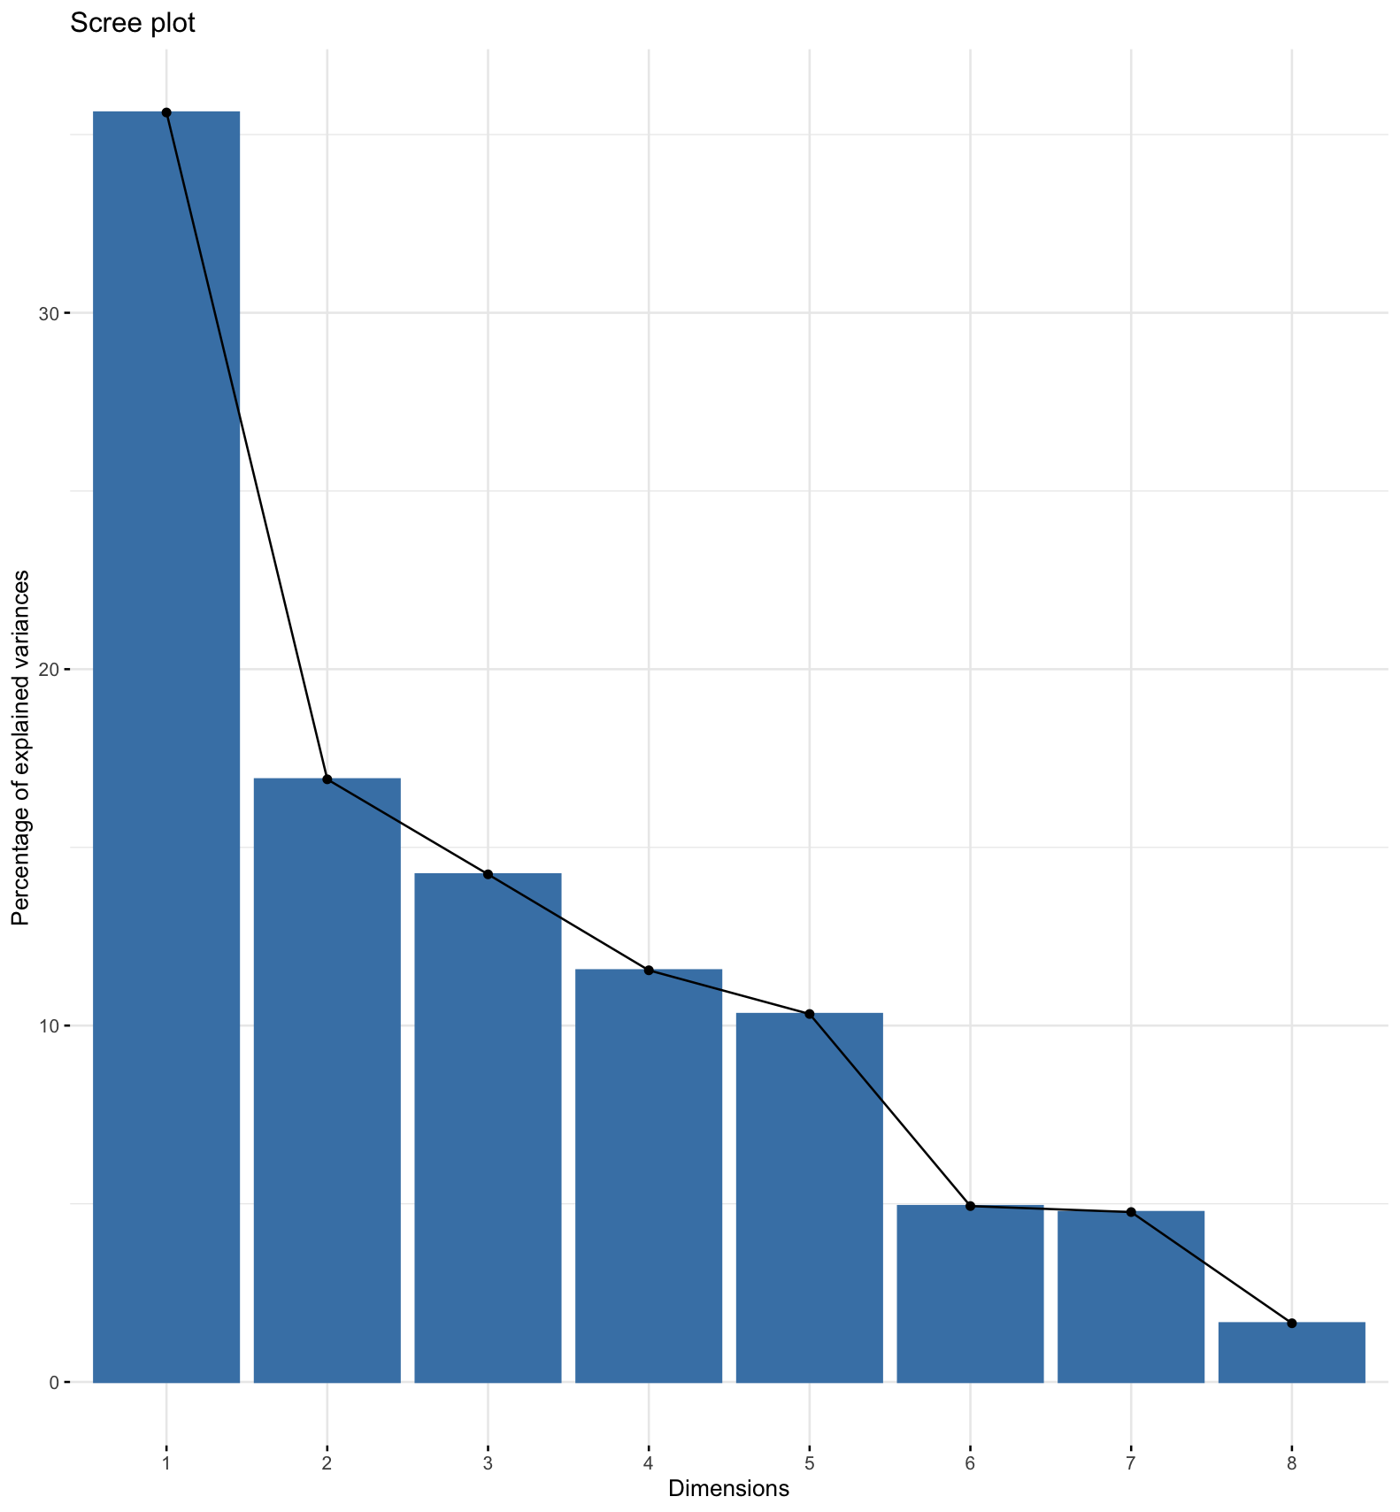
pca

Slide 16
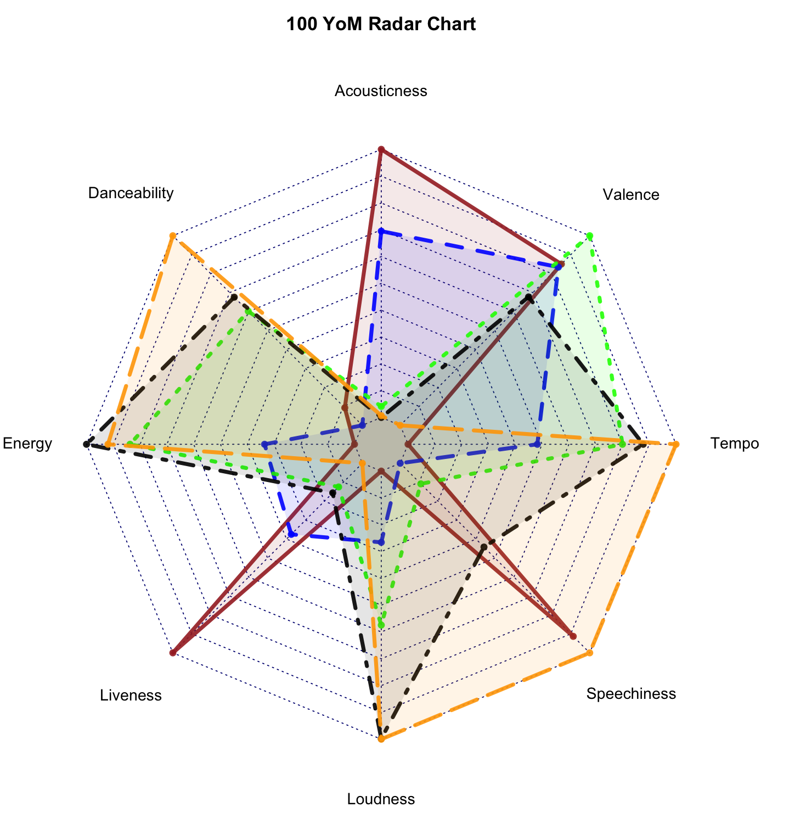
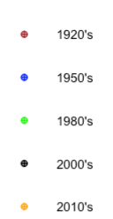
Star plot

Slide 17
Data visualization
Trend analysis
Most popular artists
Most popular songs

Slide 18
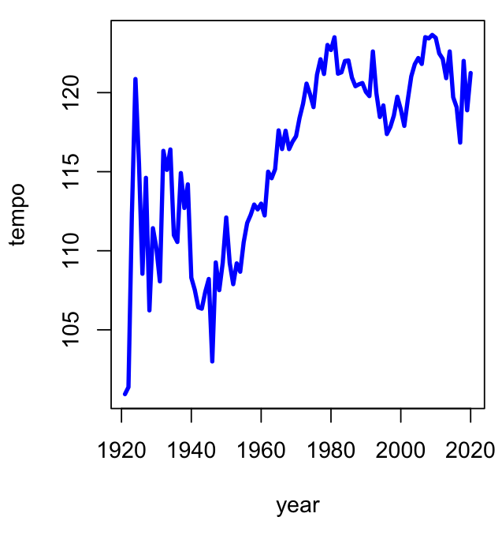
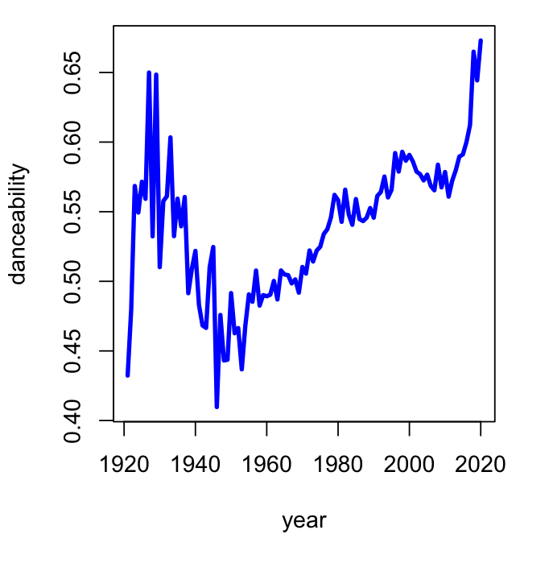
Trend analysis (1/4)
100 Years of Tempo
Let’s see if a major granularity on the x-axis (Year) can give us some more insight!
100 Years of Danceability
This graph shows how tempo has changed over the years
Between the 50’s and 80’s, music became source of cultural aggregation and the main pop medium and artistic social identifier

Slide 19
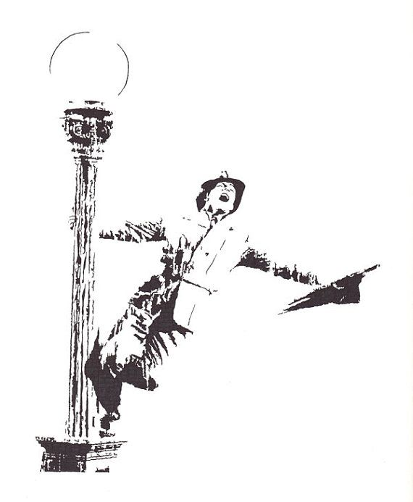
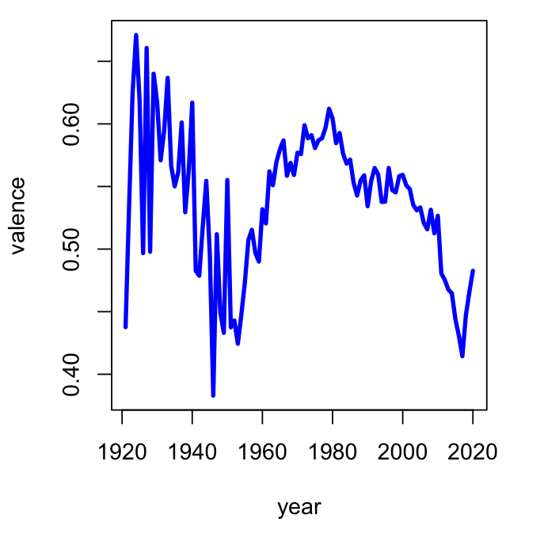
Trend analysis (2/4)
100 Years of Valence
A measure describing the musical positiveness conveyed by a track
Tracks with high valence sound more positive while tracks with low valence sound more negative
* World War II

Slide 20
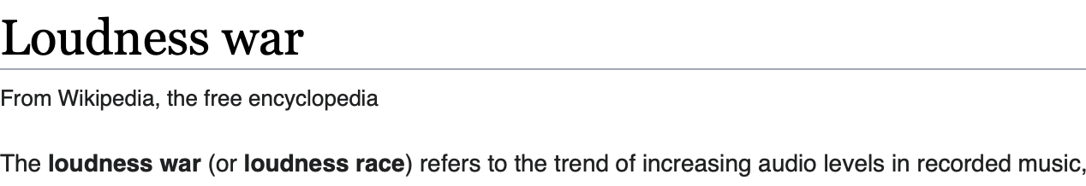
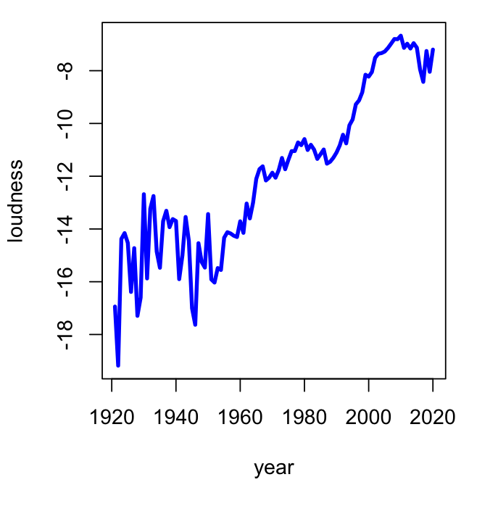
Trend analysis (3/4)
100 Years of Loudness
The album that started the loudness trend among mastering engineers
Another fun fact, this album had the most expensive recording budget in music history
Until the late 90’s loudness was only used as a tool to improve music sound across different music players.
After the 90’s higher levels of loudness were used to create a more pushed and powerful feeling in order to catch drivers’ attention while changing radio station.

Slide 21
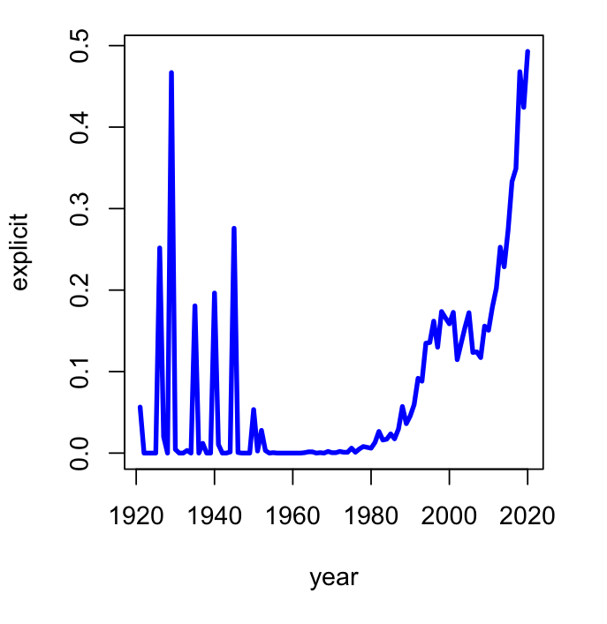
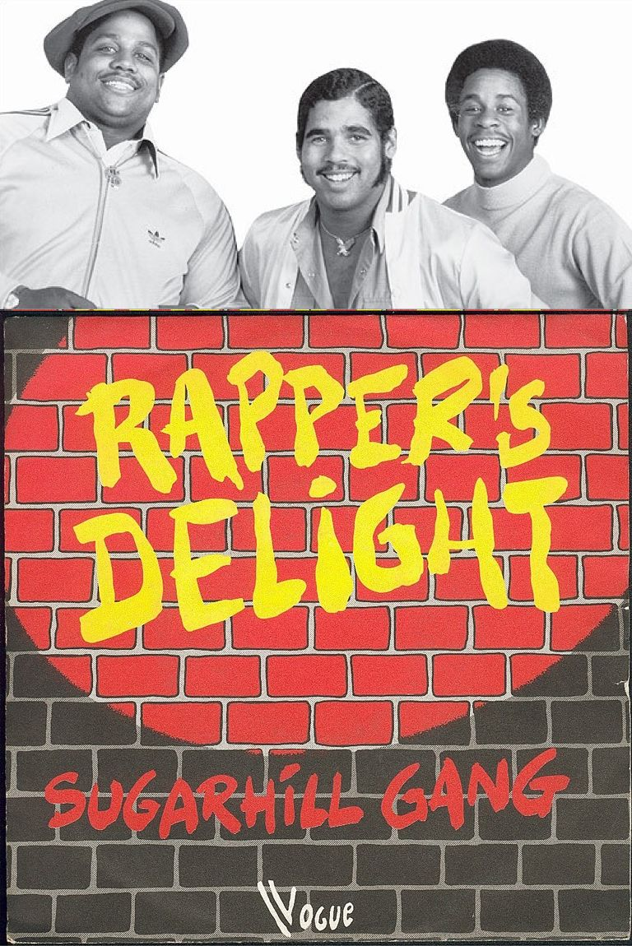
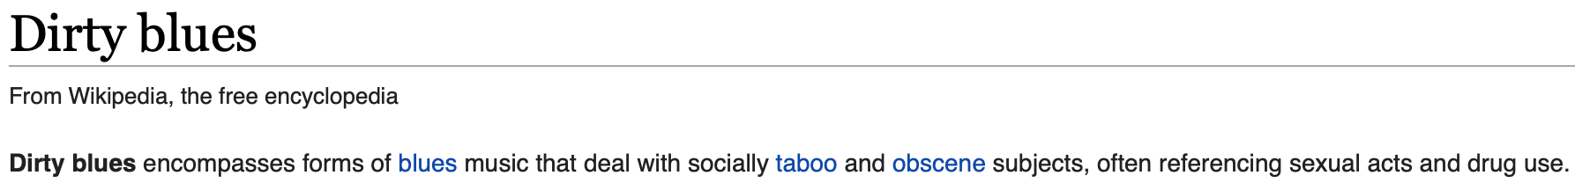
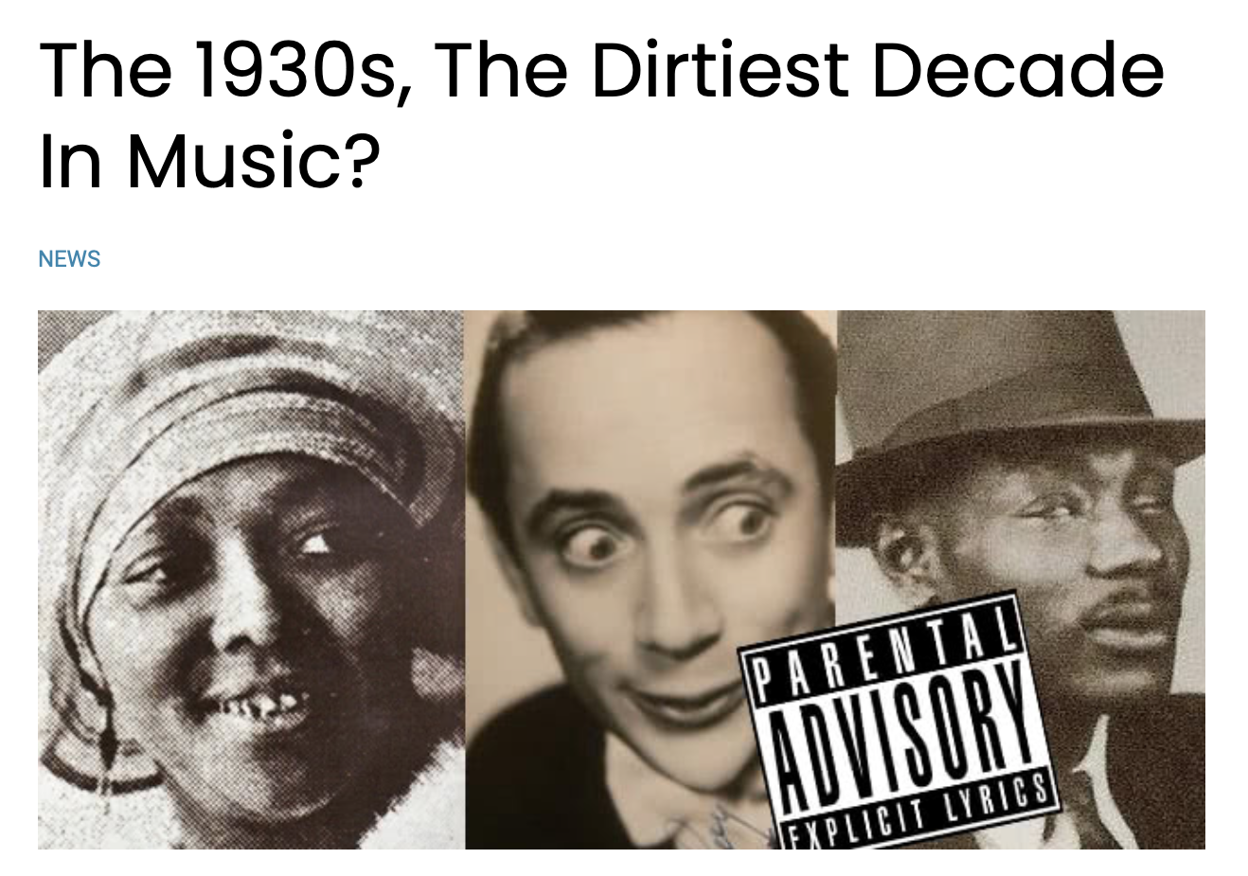
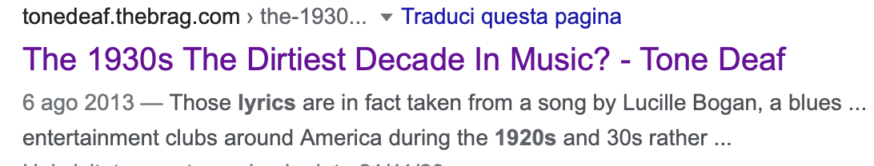
Trend analysis (4/4)
100 Years of Explicit
*
*
* The beginning of explicit content rising in early 80’s matches with the start of rap music
*
* The Sugarhill Gang’s “Rapper's Delight” (1979) is widely regarded as The first hip hop record in histroy
* It may seems unusual to see those spikes in the early days
Some research later we found out the reason!

Slide 22



Most popular artists (1/2)
I know what you are thinking...
Who are they?
These artists are ranked on the basis of the popularity mean, so just one song that is both recent and popular
I’m sure that you already heard some of them...
When artists are ranked based on their popularity sum things change
POPULARITY RANKING
(mean)

Slide 23
Most popular artists (2/2)
Other artists like the Beatles, Bob Dylan and the Rolling Stones wrote several evergreen songs
The aggregated sum of which make them the most popular artists of the dataset
POPULARITY RANKING
(sum)

Slide 24
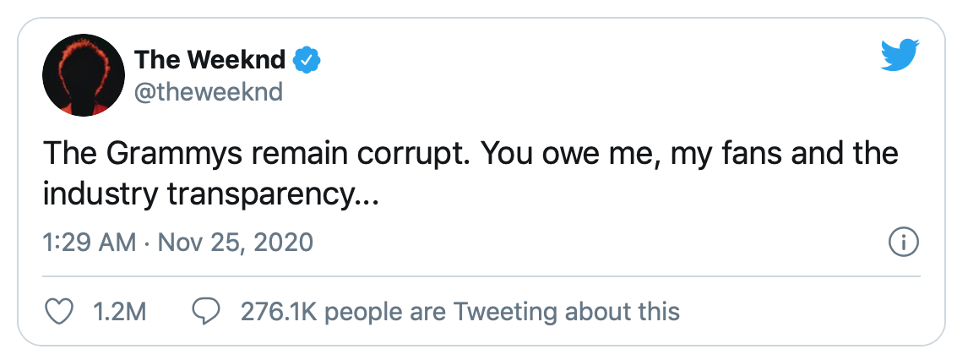
Most popular songs (2/2)
*
Most popular songs of 2020
Blinding Lights by The Weeknd
ROCKSTAR (feat. Roddy Ricch) by DaBaby
death bed (coffee for your head) by Powfu
*
POPULARITY
RANKING

Slide 25
Group composed by
Matteo Canale
Gabriele Sartor
Matteo Gatto
Federico Pomè

